Slide 1




DIGITAL LITERACY
SKILLS
ADVANCED USERS

Slide 2
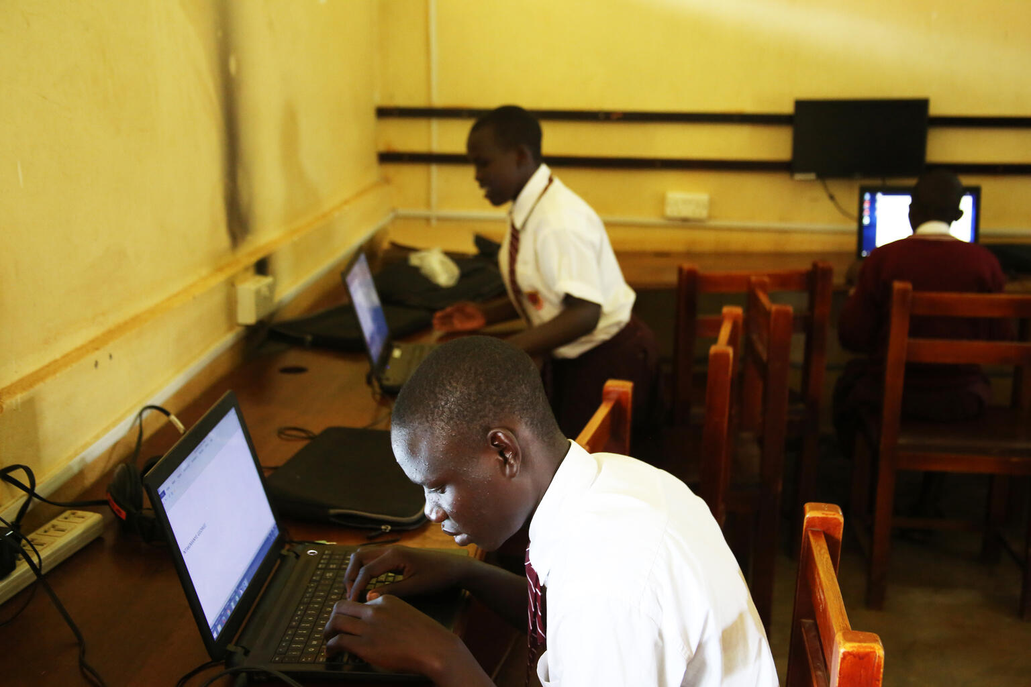
Module 6
Problem solving

Slide 3

3
Unit 3: Creatively using digital technologies

Slide 4

Digital creativity
Creativity is one of the most highly valued traits of the 21st century.
Digital creativity is a rapidly growing field.
Digital creativity is more than the sum of digital + creativity.

Slide 5
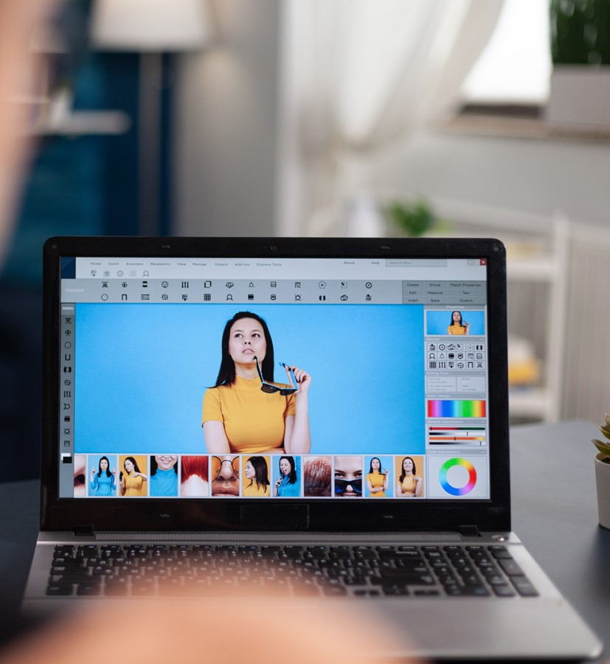
Digital creativity tools
Text editing
Photo editing app
Calendars
Social media apps
Media editing
Designing presentations
Data visualization

Slide 6
Skills to practise
Know about new technological developments
Search the internet and identify numerous vlogs and websites that discuss new developments and updates in technology (devices and hardware) or improvement to software.
Bookmark your selected sites and add them to your favourites list.
If it is a vlog, subscribe to the channel so that you receive updates.
Post a question about a problem that you do not know how to solve.
2. Practise new skills
Identify a tool or function on your device that you need help with.
Search the internet for vlogs or websites that demonstrate how to complete certain functions.
Practise your new skill.

Slide 7
All back covers should include
contact information of the section
producing the work.
© United Nations Children’s Fund (UNICEF) [month and year of publication]

